Slide 2
Unit 5: Probability Concept and Random Numbers (7 hrs)
5.1 Stochastic System
5.2 Discrete and Continuous Probability Function
5.3 Random Numbers Versus Pseudo Random Numbers
5.4 Properties of Random Numbers
5.5 Random Number Generation Techniques
5.5.1 Linear Congruential Generator
5.5.2 Mixed Generator
5.5.3 Additive and Incremental Generator
5.6 Test for Randomness
5.6.1 Uniformity Test (KS Test, Chi Square Test)
5.6.2 Independence Test (Run Test (Above and Below, Up and Down, Lengths of Runs), Test for Auto Correlation, Gap Test, Poker Test)

Slide 3
Random Numbers
Random numbers are numbers that occur in a sequence such that two conditions are met:
the values are uniformly distributed over a defined interval or set, and
it is impossible to predict future values based on past or present ones.

Slide 4
Pseudo-Random Numbers
Pseudo means false but here pseudo means that the random number are generated by using some known arithmetic operation and known mathematical formula.
Since the arithmetic operation/ formula is known and the sequence of random numbers can be repeatedly obtained, the numbers can’t be truly random.
Truly random number are generated by physical generators. For example, tossing a coin.

Slide 5
Pseudo-Random Numbers
However, the pseudo random numbers generated by many computer routines very closely fulfill the requirement of desire randomness.
If the method of random number generation i.e. random number generator, is defective, the generated pseudo random numbers,
May not be uniformly distributed.
May not be continuous.
The mean of generated numbers may be too high or too low.
The variance may be too high or too low.

Slide 6
Generation of Random Number
Random number can be generated by the following methods.
Random numbers may be drawn from the random number tables stored in the computer memory. It is very slow process and the number considerably occupy space of computer memory.
An electronic device may be constructed as part of a digital computer to generate truly random number. This is however considered as expensive.

Slide 7
Generation of Random Number
Pseudo random numbers may be generated by using mathematical formulas and arithmetic operation. This method commonly specifies a procedure, where starting with an initial number, the second number is generated and from that third number and so on. A number of recursive procedure are used for generating random number.

Slide 8
Generation of Random Number
One of the method for generating PRN is Mid square method.
It starts with a fixed initial value, say 4-digit integer, called seed.
The seed is squared, and the middle 4 digits of the resulting number is extracted.
Use these middle 4 digits as new seed to generate third random number and so on.
We may also have to add zero to make the digit’s length eight if necessary.

Slide 9
Generation of Random Number
Finally, Divide each 4-digit number by 10,000 to convert it into a uniform random number in (0,1).
Example: if we take seed Z₀ = 1234, then we will get the sequence of numbers as 0.1234, 0.5227, 0.3215, 0.3362, 0.3030, 0.1809……………………...

Slide 10
Qualities of an Efficient Random Number Generator
Should be fast and cost-effective
Should be portable to different computer and ideally to different programming language
Should have sufficiently long cycle, i.e., sufficiently long sequence of random numbers before beginning to repeat the sequence
Should be replicable, i.e., specifying a starting condition it should be possible to obtain the same set of random numbers
Should hold ideal statistical properties (uniformity and independence)

Slide 11
Random Number Generation Techniques
Linear Congruential Method (LCM)
Mixed Generator
Additive
Incremental Generator

Slide 12
Linear Congruential Method (LCM)
The most widely used technique for generating random numbers, initially proposed by Lehmer [1951].
This method produces a sequence of integers, X₁, X₂ … between 0 and m-1 by following a recursive relationship:
X_{i+1} = (aX_{i} + c) mod m, i = 0, 1, 2, …
Where a, c, m are constants,
The initial value X₀ is called seed. The selection of the values for a, c, m, and X₀ drastically affects the statistical properties and the cycle length.

Slide 13
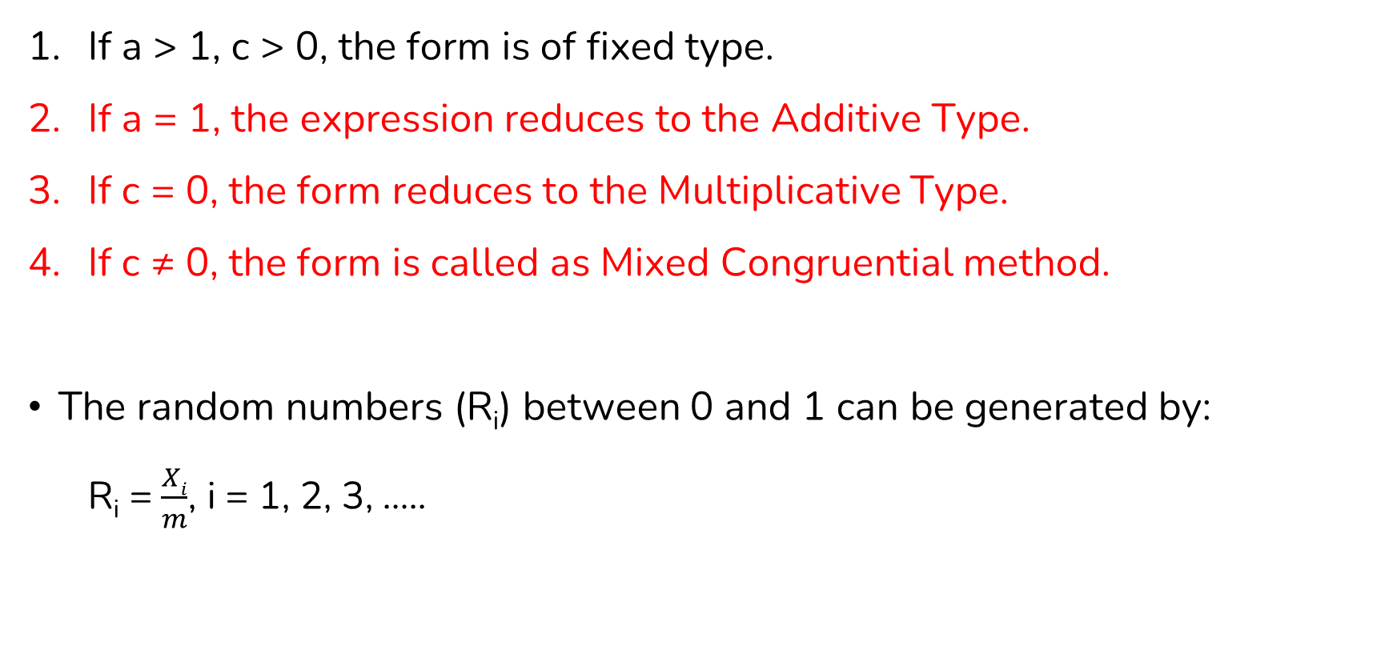
Linear Congruential Method (LCM)
If a > 1, c > 0, the form is of fixed type.
If a = 1, the expression reduces to the Additive Type.
If c = 0, the form reduces to the Multiplicative Type.
If c ≠ 0, the form is called as Mixed Congruential method.
The random numbers (R_{i}) between 0 and 1 can be generated by:
R_{i} = $\frac{Xi}{m}$, i = 1, 2, 3, …..

Slide 14
Linear Congruential Method (LCM) Numerical
Use linear congruential method to generate sequence of random numbers with X₀ = 27, a = 17, c = 43, and m = 100.
Solution,
Equations → X_{i+1} = (aX_{i} + c) mod m, R_{i} = X_{i} / m , i=1, 2, 3, …..
X₁ = (17 * 27 + 43) mod 100 = 2, R₁ = 2 / 100 = 0.02
X₂ = (17 * 2 + 43) mod 100 = 77, R₂ = 77 / 100 = 0.77
X₃ = (17 * 77 + 43) mod 100 = 52, R₃ = 52/ 100 = 0.52
X₄ = (17 * 52 + 43) mod 100 = 27, R₄ = 27/100 = 0.27
Hence the random numbers are generated are 0.02, 0.77, 0.52, 0.27.

Slide 15
Linear Congruential Method (LCM) Numerical
Use linear congruential method to generate sequence of random numbers with X₀ = 27, a = 17, c = 43, and m = 100.
Solution,
Generated Random Number Sequence (mod 100):
27, 2, 77, 52, 27, 2, 77, 52, 27, 2
The sequence starts repeating from the 5th number.
So, the cycle length is 4 (27 → 2 → 77 → 52 → 27).
This is called the period of the generator.

Slide 16
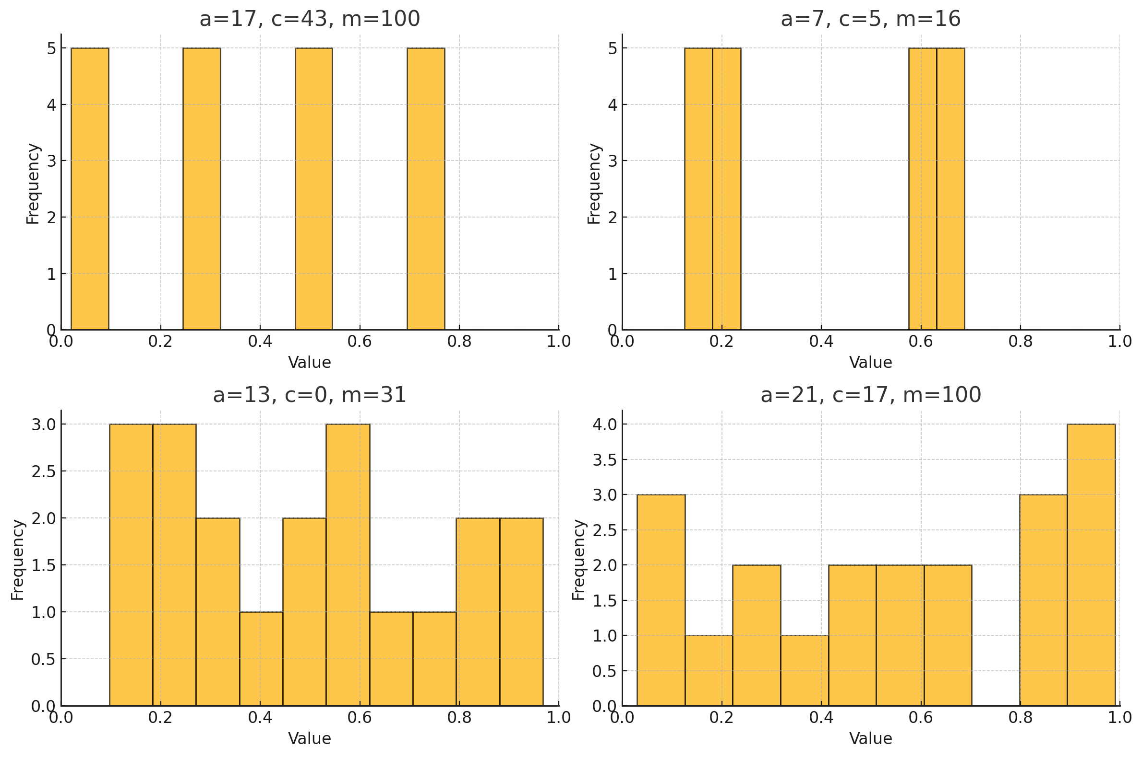
Linear Congruential Method (LCM) Numerical

Slide 17
Mixed Generator
This is a type of Linear Congruential Generator with both multiplier and increment:
X_{n+1​} = (aX_{n}​ + c) mod m, where c ≠ 0.
Advantage: Can achieve full period length.
Use case: Simulations requiring long non-repeating sequences.

Slide 18
Incremental Generator
A simpler variant where each new value is obtained by adding a fixed value or increment.
X_{n+1​} = (X_{n}​ + c) mod m, where c ≠ 0.
Not as random as other methods
Useful when a quick, repeatable pattern is acceptable

Slide 19
Additive Generator
Also known as, Arithmetic Congruential Generator or, Lagged Fibonacci Generator.
Requires a buffer of initial values.
Instead of multiplication, this method adds two or more previous numbers in the sequence.
Formula:
X_{n} = (X_{n − j} + X_{n - k} ) mod m (where j < k)
Or, X_{i+1} = X_{i-1} + X_{i} mod m

Slide 20
Additive Generator Numerical
Let r₁ = 9, r₂ = 13, m = 17, generate the random numbers sequence using Additive method.
r₃ = (r₁ + r₂) mod m = (9 + 13) mod 17 = 5
r₄ = (r₂ + r₃) mod m = (13 + 5) mod 17 = 1
r₅ = (r₃ + r₄) mod m = (5 +1) mod 17 = 6
r₆ = (r₄ + r₅) mod m = (1 + 6) mod 17 = 7
Therefore, the generated random numbers sequence are 9, 13, 5, 1, 6, 7 and so on.

Slide 21
End of Lecture 15

Slide 22
Test for Randomness

